Slide 1
Stress Score Analysis
Team B5: Lujain Alqassar, Yesol Lee, Shrey Sood, Ta-Wei Wang, Yilun Wang

Slide 2
TABLE OF CONTENTS
01
02
03
Business Problem
Data Set
Exploratory Data Analysis (EDA)
04
05
06
Dimensionality Reduction
Clustering
Text Analysis
07
Conclusion & Recommendations
Notes:
Shrey

Slide 3
01
Business Problem
Notes:
Shrey

Slide 4
Business Problem
Omicron Inc. wants to assess the mental health of their employees and determine its impact on their individual workplace productivity. We asked them to fill out a survey consisting of a mix of 50 questions and based on their answers we predicted their stress scores.
Notes:
Shrey

Slide 5
02
Data Set Exploration
Notes:
Shrey

Slide 6
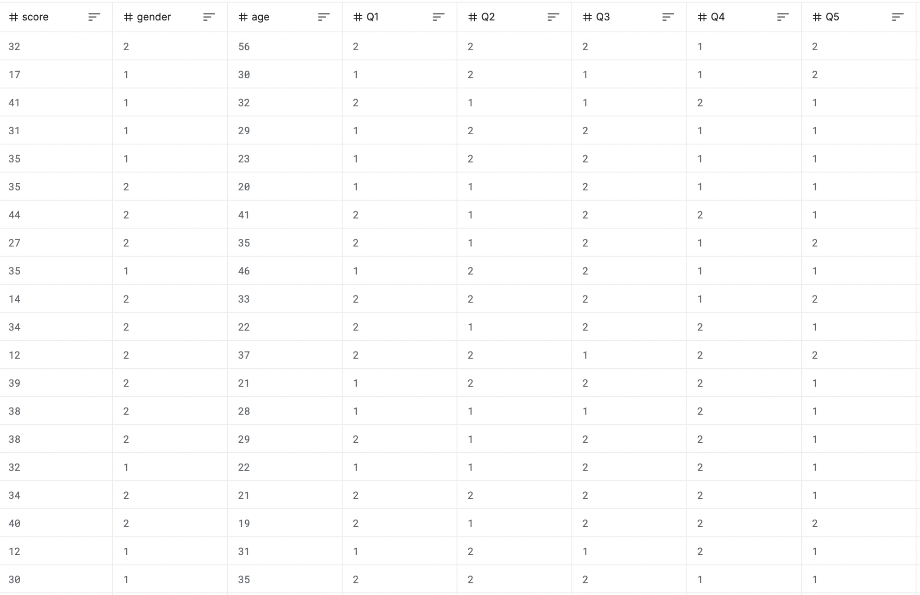
Datasource & Dataset
Source : https://www.kaggle.com/yamqwe/taylor-manifest-anxiety-scale
Dataset: Our dataset consists of 5410 rows and 53 columns.
Variables:
Anxiety Score
Age
Gender
Survey Questions 1-50
Notes:
Shrey

Slide 7
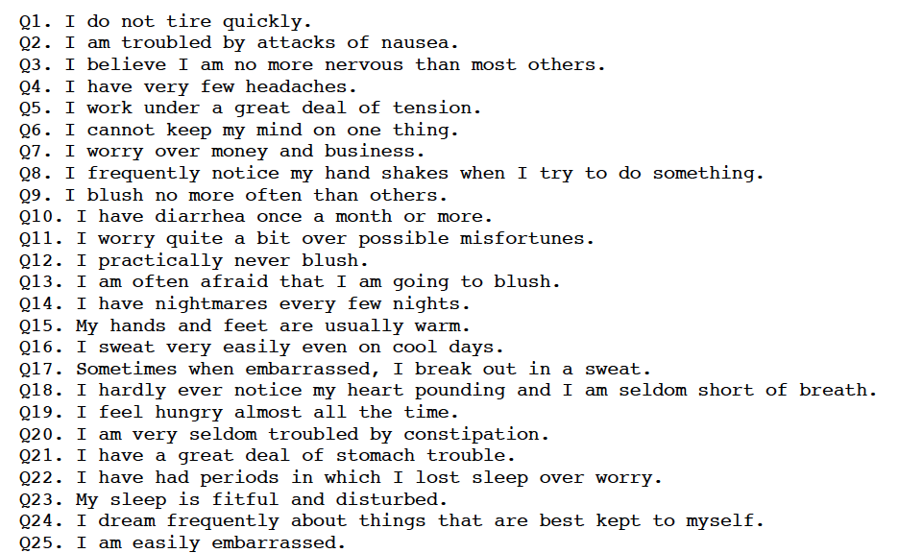
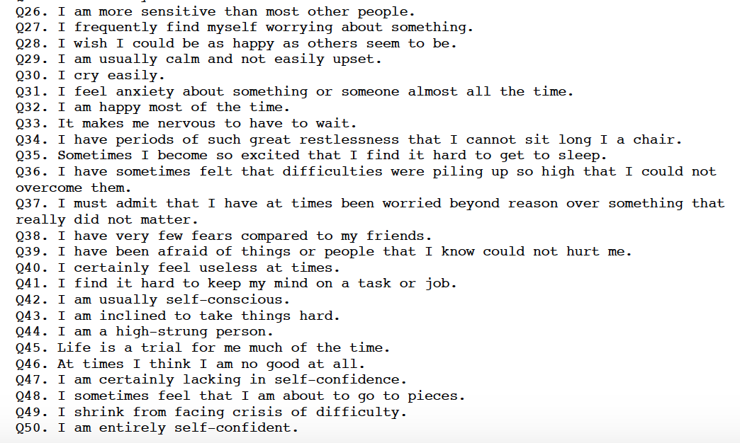
Survey Questions
Notes:
Shrey

Slide 8
03
Exploratory Data Analysis (EDA)

Slide 9
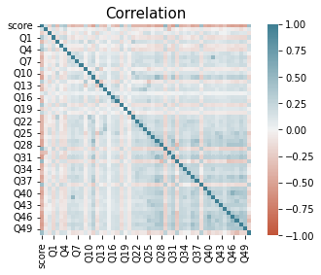
Correlation Matrix & Heatmap
See if there were any correlation between the questions and other variables, such as age and gender.
Some questions have negative relationships with score while others are heavily positively correlated
Notes:
Yilun

Slide 10
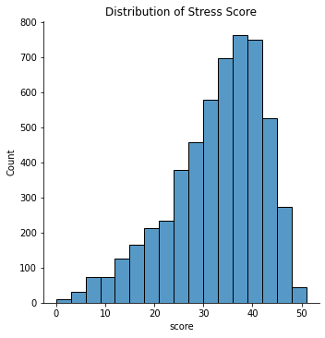
Distribution of Stress Score
Mean stress score is around 30-40 out of 50.
More right leaning towards higher score.
Notes:
Yilun

Slide 11
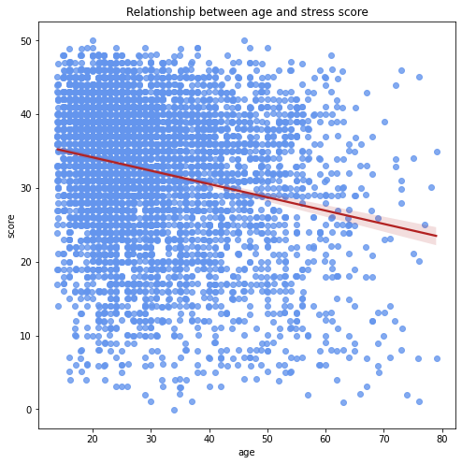
Distribution of Stress Score by Age
Majority of people in their 20s and 30s have higher stress scores.
Notes:
Lujain

Slide 12
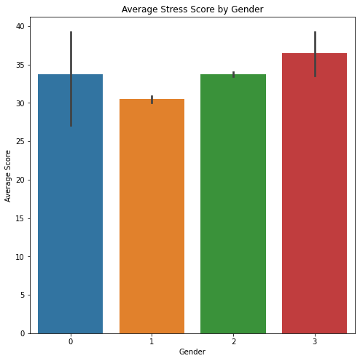
Average Stress Score by Gender
0: None, 1: Male, 2: Female, 3: Other
Females and people identifying as others have higher anxiety scores
Notes:
Yilun

Slide 13
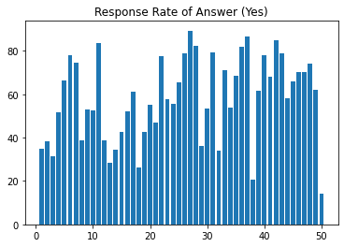
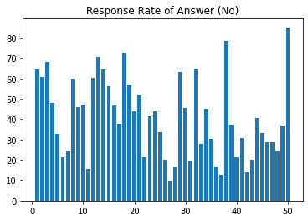
Response Rate
The response rate for Yes is more evenly distributed than No.
Notes:
Yilun

Slide 14
04
Dimensionality Reduction
Notes:
Lujain

Slide 15
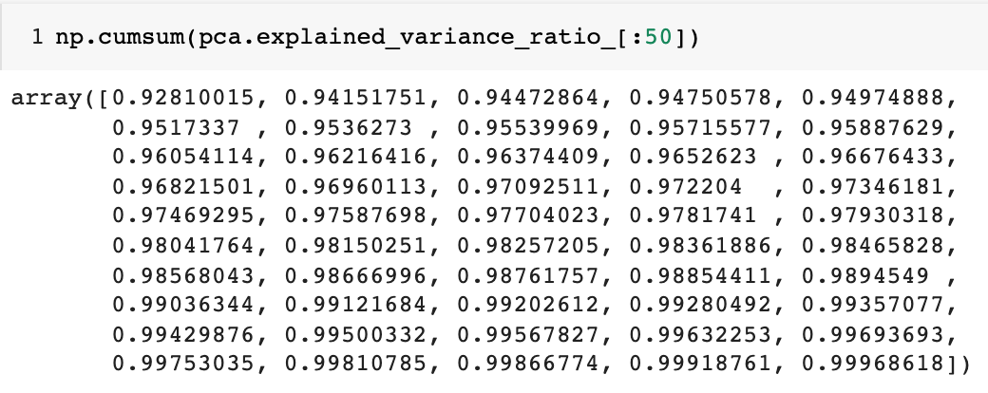
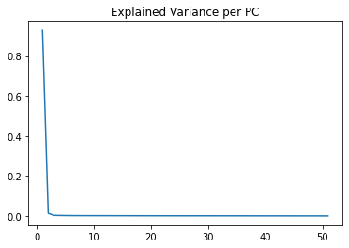
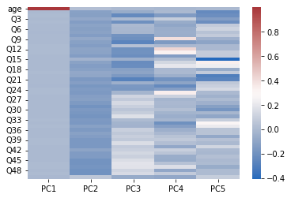
PCA → First Attempt
Wanted to see if we can reduce number of variables in the dataset.
Removed variables score and gender.
Notes:
Lujain

Slide 16
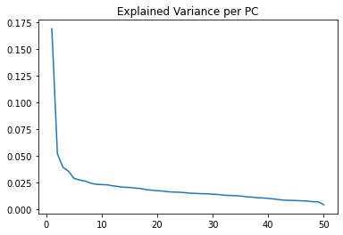
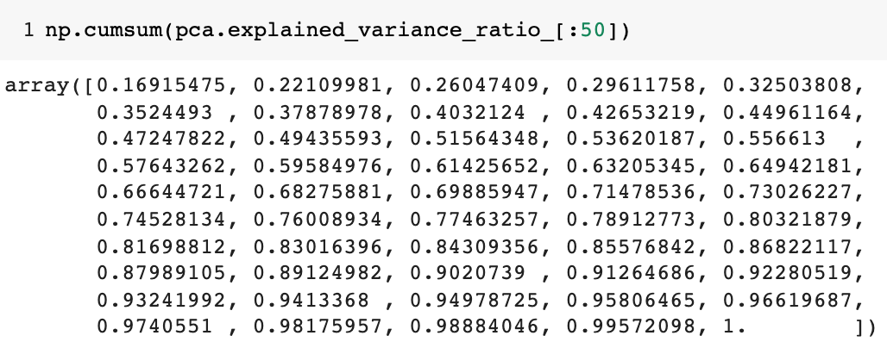
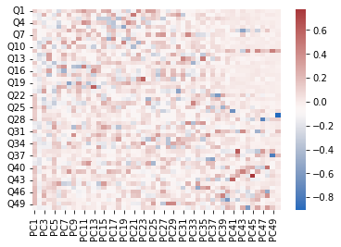
PCA → Second Attempt
Removed age as well since it had such a big range and impact on the PCAs
Notes:
Lujain

Slide 17
Decided to scrap PCA all together!

Slide 18
05
Clustering
Clustering Respondents
And Questions
Notes:
Sally

Slide 19
Clustering Respondents
Notes:
Sally

Slide 20
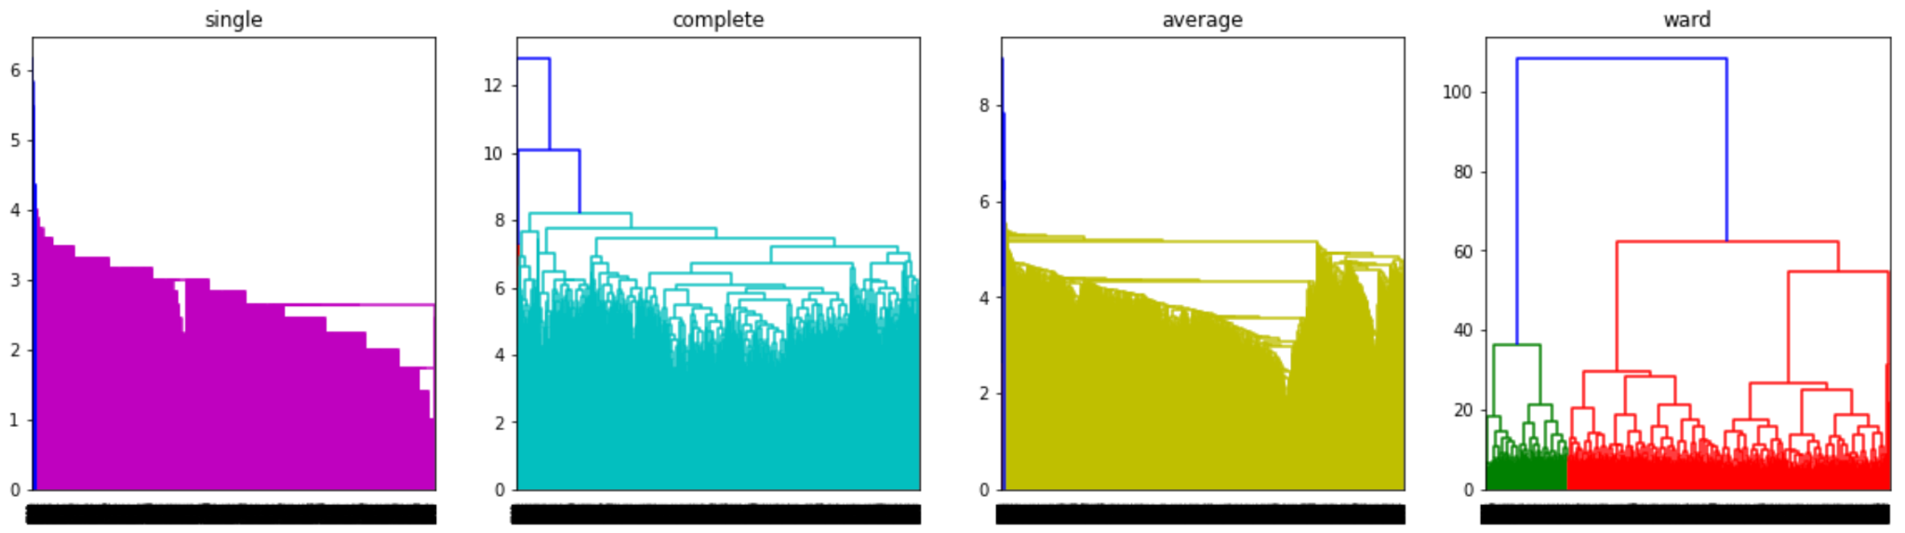
Hierarchical Clustering
Investigated 8 possible combinations of distance metric and linkage methods
Dendrograms using Euclidean Distance
Notes:
Sally

Slide 21
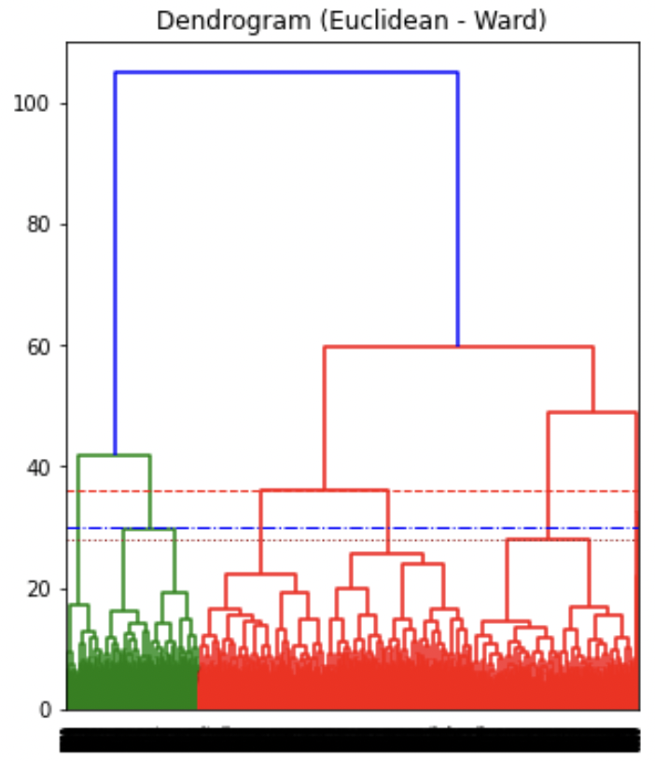
Hierarchical Clustering
Distance 36: 6 clusters
Distance 30: 7 clusters
Distance 28: 9 clusters
Notes:
Sally

Slide 22
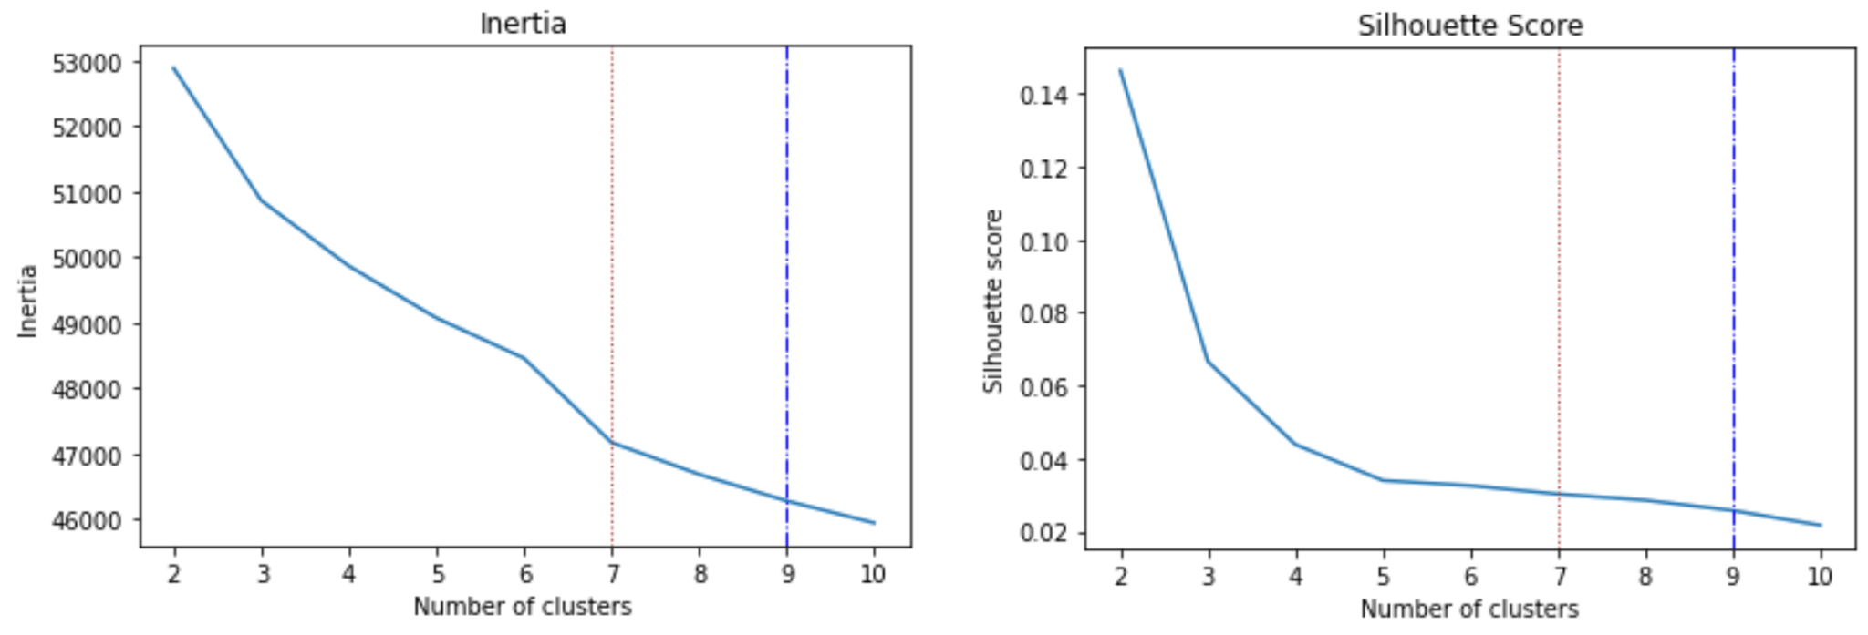
K-Means Clustering
Elbow Plot
Silhouette Score Plot
Not Clear elbow
Score at 7 is low enough
Overall very low silhouette Score
Notes:
Sally

Slide 23
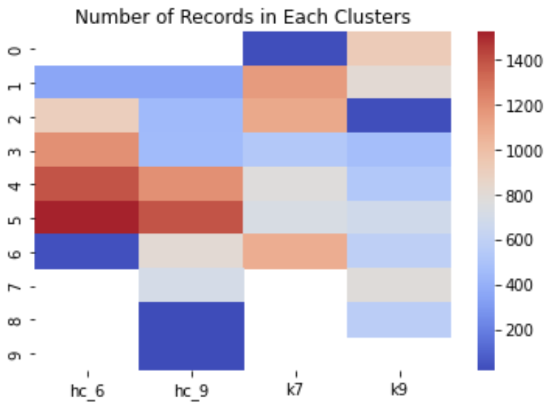
Comparing Clustering Results
K-means showed very low silhouette score
Hierarchical > K means
More distance between the clusters
Hierarchical clustering with 6 groups
Notes:
Sally

Slide 24
Final Clusters
Cluster | Number of data | Average Score | Average Age
1 | 356 | 12 | 37
2 | 905 | 24 | 31
3 | 1196 | 36 | 29
4 | 1391 | 30 | 30
5 | 1520 | 41 | 28
6 | 38 | 16 | 34
Notes:
Sally

Slide 25
Clustering Questions
Notes:
Sally

Slide 26
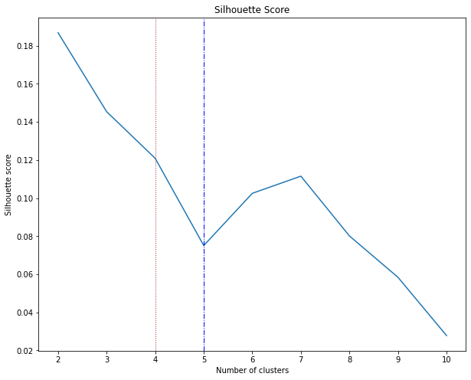
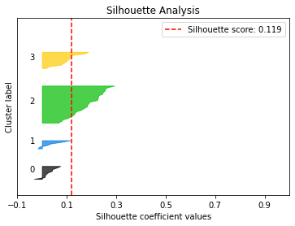
Clustering by Questions
Silhouette Score Plot
We chose 4 for the number of clusters.
Notes:
David

Slide 27
Clustering Questions into 4 Groups
Group 1 | Q2, Q9, Q10, Q13, Q16, Q19, Q20, Q21, Q30
Group 2 | Q4, Q8, Q14, Q23, Q24, Q34
Group 3 | Q1, Q6, Q7, Q11, Q17, Q22, Q25, Q26, Q27, Q28, Q31, Q35, Q36, Q37, Q40, Q41, Q42, Q43, Q44, Q45, Q46, Q47, Q48, Q49
Group 4 | Q3, Q5, Q12, Q15, Q18, Q29, Q32, Q33, Q38, Q39, Q50
Take Group 2 as example
Q4. I have very few headaches.
Q8. I frequently notice my hand shakes when I try to do something.
Q14. I have nightmares every few nights.
Q23. My sleep is fitful and disturbed.
Q24. I dream frequently about things that are best kept to myself.
Q34. I have periods of such great restlessness that I cannot sit long I a chair.
Notes:
David

Slide 28
06
Text Analysis
Word Cloud, Sentiment Analysis
Notes:
David

Slide 29
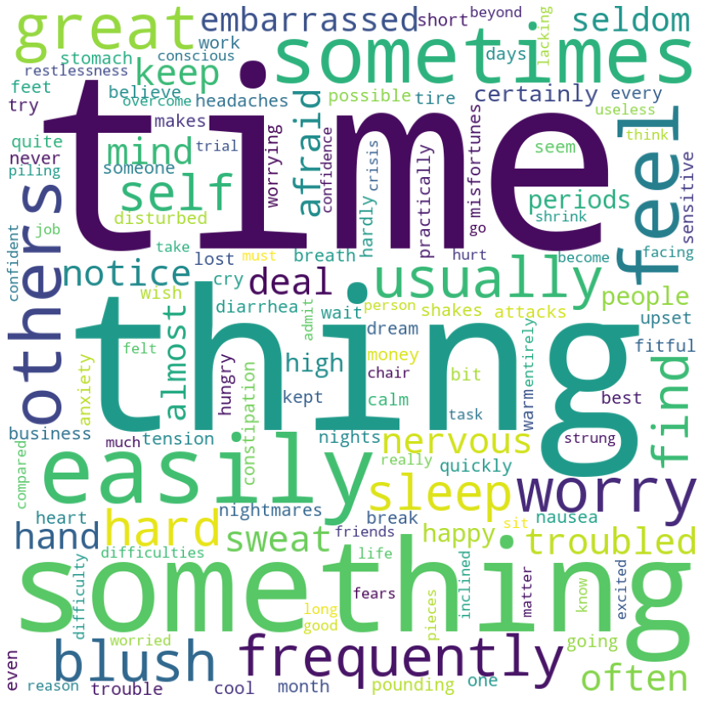
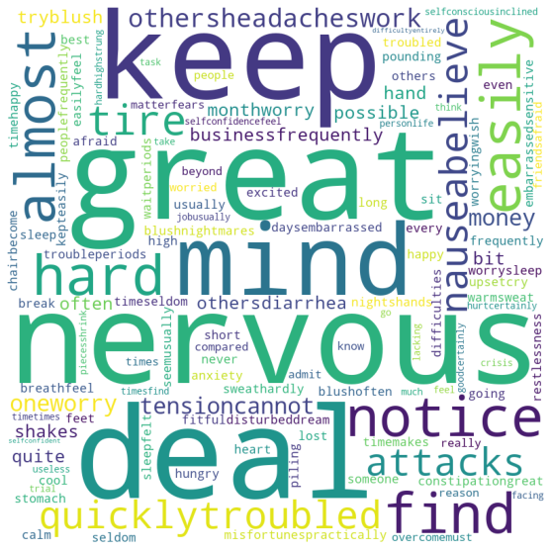
Word Cloud
Before filtering Stopwords:
After filtering Stopwords:
Notes:
David

Slide 30
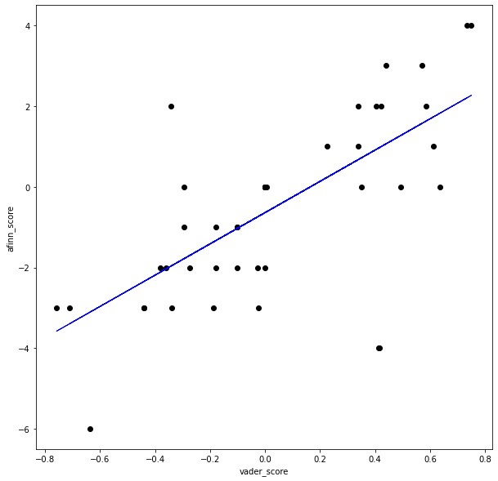
Sentiment Analysis
Afinn score only provides integers.
Vader sentimental score method from nltk package that gives floating number results.
They share a positive relationship.
Notes:
David

Slide 31
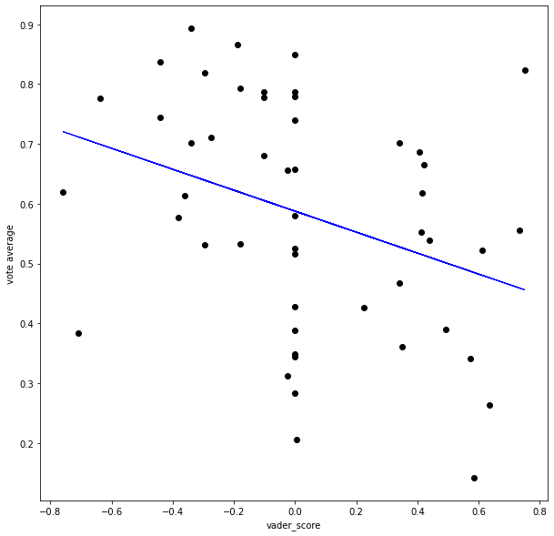
Sentiment Analysis
Negative relationship between sentiment score and testers’ tendency to answer “True”.
Intuitive for this experiment thinking that participants who took the test are troubled and willing to agree with questions with a more negative sentiment score.
Notes:
David

Slide 32
07
Conclusion & Recommendations
Notes:
Shrey

Slide 33
Recommendations
We may cluster based on the respondents. This tells us about the characteristics of similar respondents being clustered together.
We may also cluster based on questions. By doing so we find questions with similar emotional connotations being clustered together.
When the survey is sent out, it must be a prerequisite that the respondents answer all the questions or else this would pave the way for inconsistency.
Notes:
Shrey

Slide 34
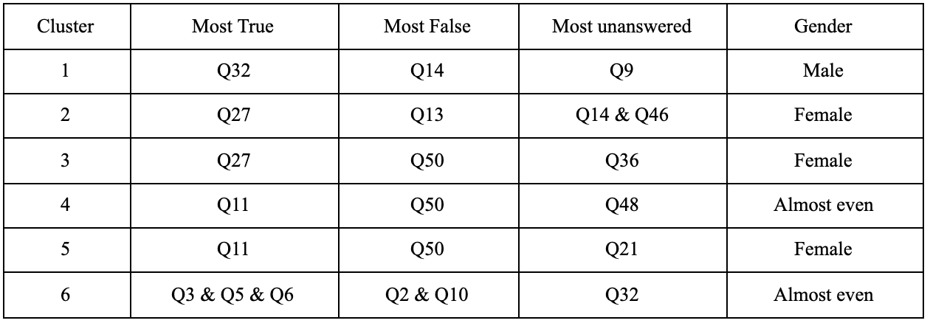
Conclusion
PCA is not an ideal technique for dimensionality reduction. Even 40 dimensions were only able to explain 80% of the variation in the model.
Our entire model can be explained using 6 clusters.
Notes:
Shrey

Slide 35

Thank You!

